Slide 1
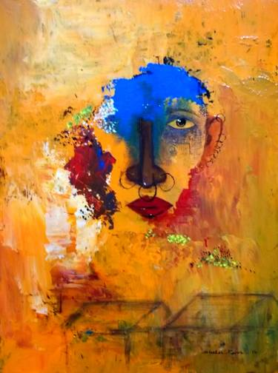
No mother tongue in our
tongues: a postcolonial
study of the status of English and Hindi in present-day Odisha
A PRESENTATION
BY DR.MANISHA MISHRA
Assistant Professor of English
R.D Women’s University

Slide 2
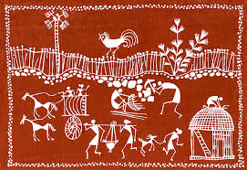
Even after 71 years of Independence, postcolonial hangover still persists.
Odisha is no exception. One of the repercussions of this is the growing precedence of the other tongue over the mother tongue. The scope of my paper is to study the negative consequences of language diversity in Odisha that has become a threat to Odia language.
SCOPE OF MY PAPER

Slide 3
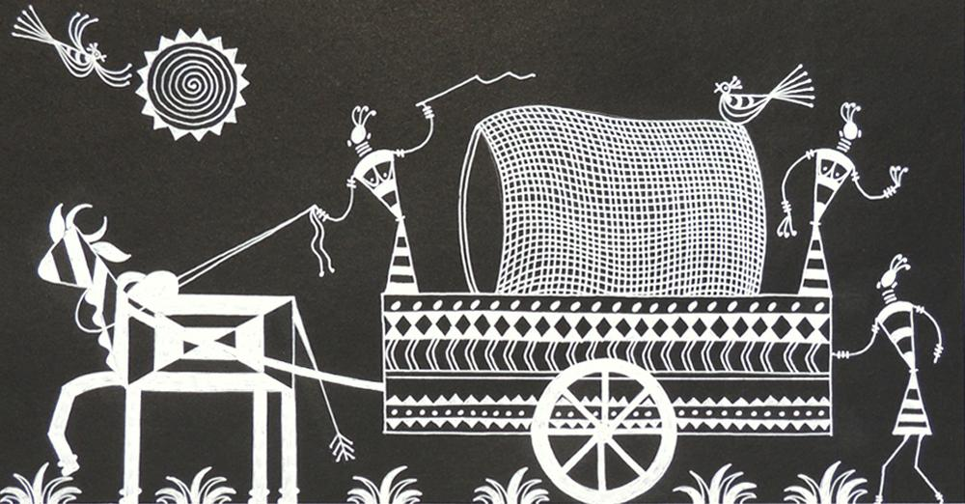
The purpose of my research is to find out the reasons behind the phenomenon of Odia people drifting away from using their mother tongue. I have used empirical survey method to arrive at my conclusions. The survey was done among the urban elites of Odisha- a wide range of people from academicians, media persons to language experts, sociologists, government and non-governmental organisations.
RESEARCH INTENT AND METHODOLOGY

Slide 4
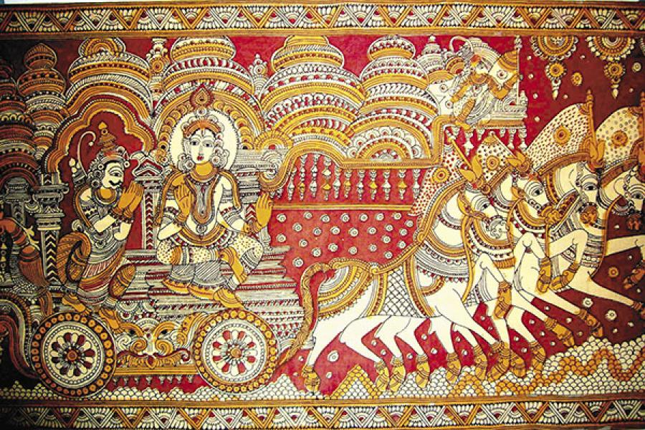
CASE STUDY 1: GARIMA
CASE STUDY 2: RAJA NARAYAN
CASE STUDY 3: SAMBIT AND RAVI
GREETINGS
LANGUAGE AT PUBLIC PLACES
LANGUAGE SCENARIO IN ODISHA TODAY

Slide 5
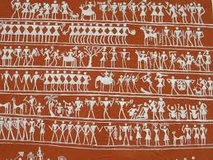
STATUS OF HINDI VIS-À-VIS STATUS OF ENGLISH AND ODIA IN ODISHA
USING ODIA AND INFERIORITY COMPLEX
ODIA AND YOUNGER GENERATION ODIAS
BOOKS IN ODIA AND ITS STATUS
ODIA NOT SO TECHNO-SAVVY
HINDI VS ENGLISH/ODIA IN ODISHA

Slide 6
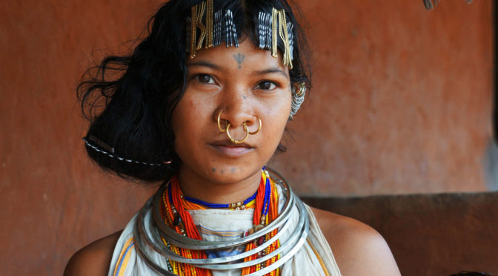
GREATER THREAT: HINDI OR ENGLISH?
Both Hindi and English are trying to push Odia behind but Hindi is a bigger threat. English is elitist but Hindi is growing due to Bollywood and other reasons. The common Odia aspires and finds it easier to pick up Hindi compared to English. Hindi is seen as a status enhancer for the masses. Even the middle class Odia families have started using Hindi in their close circles.

Slide 7
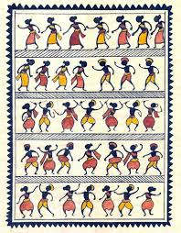
COUNTER MOVEMENTS & GOVERNMENT INITIATIVES
THREAT TO VERNACULAR LANGUAGES, LOCAL CULTURES AND IDENTITIES
MANDATORY USE OF ODIA IN HOARDINGS AND SIGNAGES
MORE RESEARCH-ORIENTED TEXTS IN ODIA
ODIA: INTEGRAL PART OF THE ACADEMIC CURRICULUM
ODIA ENTERTAINMENT INDUSTRY

Slide 8
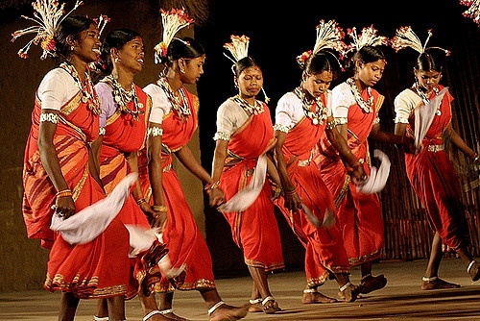
Diversity of languages in Odisha is not an unwelcome thing. Proficiency in Hindi and English is not bad, but not at the cost of Odia. However, language and diversity cease to exist if there are no speakers of the language, as pointed out by Dr. G. Rajagopal in the inaugural session. It is our duty not to allow any language to die. When languages die, how can they create diversity?
CONCLUSION

Slide 9
THANK YOU
FOR
PATIENT
LISTENING

